Slide 1
Async IO, Non Blocking IO, Blocking IO and Multithreading
By Bhavin Turakhia
CEO, Directi
bhavin.t@directi.com

Slide 2
Agenda
Multithreading
Blocking IO
Async Blocking IO
Async Non Blocking IO

Slide 3
Introduction
A program performs the following activities –
  Requests Input
  Performs Computations
  Publishes Output
A program requires the following resources
  CPU
  Memory
A CPU can only do one thing at a time

Slide 4
Scenario 1 – Computational Task
Person => Process
God => CPU
Task
  Inspect the Bucket (purely computational)
Will adding additional Persons help?
God is busy all the time doing exactly what we want ie computing
GOD

Slide 5
Rule 1 – We always want to keep God Busy
Rule 1 – We always want to keep the CPU Busy

Slide 6
Scenario 2 – Same Task – Multi-Process
Persons => Processes
God => CPU
Task
  Inspect the Bucket (purely computational)
Now God is busy all the time but not doing what we want
  Spends time picking up person A
  Spends time computing
  Spends time putting person A down
  Repeat with person B
GOD

Slide 7
Rule 2 – We want to keep God Busy doing important stuff. Switching between Persons is not the best utilization of God’s time
Rule 2 – We want to keep the CPU Busy doing important stuff. Switching between processes is not the best utilization of the CPUs time

Slide 8
Corollary – Multiple processes reduce performance for tasks that are CPU-bound
GOD

Slide 9
Scenario 2 - IO
Person => Process
God => CPU
Bucket => Input
Task
  Wait for Bucket to be filled (Input)
  Inspect Bucket (Compute)
GOD

Slide 10
But God is twiddling his thumbs while the bucket is filling!!!

Slide 11
Rule 1 – We always want to keep God Busy

Slide 12
Scenario 3 – Multiple Processes
Persons => Processes
God => CPU
Bucket => Input
God can now switch between Persons while they are “blocked” on Input
GOD

Slide 13
Rule 3 – If a person is waiting for his bucket to be filled, God can drop him and pick up another person
Rule 3 – If a process is waiting for IO, the CPU can switch its attention to another Process (context switching)

Slide 14



But Persons are Heavy!!!

Slide 15
Scenario 4 – Multi-threading
Person => Process
Hands => Threads
God => CPU
Bucket => Input
One Hand per bucket
God can now switch between Hands while they are “blocked” on Input
If God picks a hand whose bucket is full, God begins computation
Switching between hands is faster than switching between persons
GOD

Slide 16
Rule 4 – God can switch between hands, faster than switching between persons
Rule 4 – The CPU can switch between threads, faster than switching between processes

Slide 17
Threads vs Processes
Threads take up lesser memory -> lesser context switching time -> more efficient CPU utilization
Lean towards multi-threaded servers as opposed to multi-process servers
  Keep in mind other parameters of the application (eg MySQL does not necessarily win Postgres vs MySQL)
  Async IO will outperform both (depending on the application)
More Tips
  Try and keep the memory utilization of threads to a minimum
  Try and use separate thread pools to perform separate tasks. That way each thread only has as much context as it requires

Slide 18
Scenario 5 – Async Blocking IO
Person => Process
Hands => Threads
God => CPU
Bucket => Input
All buckets scanned periodically to check which one is full
Number of hands required < Num of buckets (in some cases only 1)
Lesser hands => Lesser context switching
select() or poll()
GOD

Slide 19
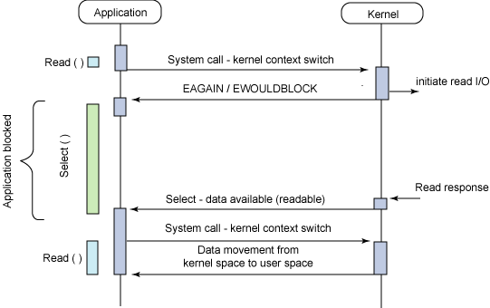
Scenario 5 – Async Blocking IO
select() and poll() can be used to check status of multiple file descriptors
poll() supports unlimited file descriptors while select() has a limit
Both calls however are blocking calls, for the duration of the scan
Both support a timeout parameter to reduce blocking

Slide 20
Scenario 6 – Async Non-Blocking IO
Person => Process
Hands => Threads
God => CPU
Bucket => Input
The bucket notifies God that I am done
Number of hands required = 1
Epoll(), KQueue
GOD

Slide 21
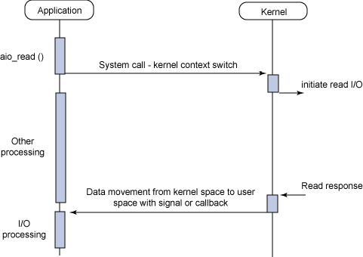
Scenario 5 – Async Blocking IO
epoll() and Kqueue()

Slide 22
Advantages of Async Non-blocking IO
Removes requirement of threads -> eliminates context switching

Slide 23
Is there a scenario where I would want multiple threads even if I use Async I/O ??

Slide 24
Scenario 6 – More than 1 GOD
Each God can only do one thing at a time
With Async IO, if I have two Gods, I should have two hands
This applies to CPUs and CPU Cores
  Eg Dual Core Dual CPUs => 4 threads
GOD
GOD

Slide 25
Software you need to be aware of
select(), poll(), epoll() in Linux
Kqueue() in BSD
AIO
Posix AIO for Disk IO
Twisted
Libevent
JDK now supports Async IO
Apache MINA
Project Grizzly (erstwhile Glassfish)

Slide 26
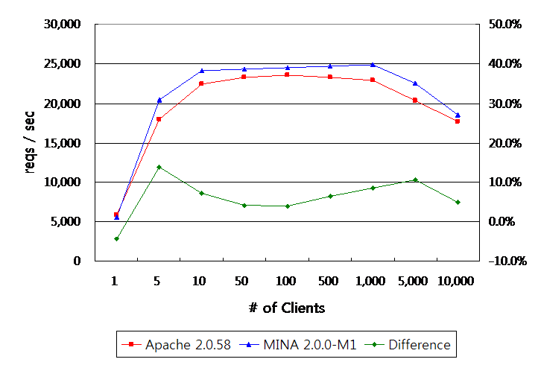
Async IO Success Stories
Tomcat 6.0 – 16000 simultaneous connections
Apache MINA + Async Web

Slide 27
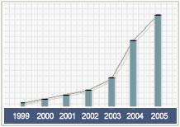
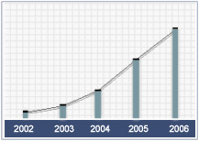
About Directi
A $300 million tech enterprise
500+ employees and growing
Ranked amongst the fastest growing Tech companies by Deloitte and Touche for
2005, 2006 and 2007
Revenue and headcount more than doubles every year
(Revenue Growth Chart)
(Employee Growth Chart)

Slide 28
Facts about Products@Directi
Some of Our myriad Products and Services -
  crawl over 90 million domains
  provide web services to millions of users
  power 3+ million domains
  run on infrastructure spanning hundreds of distributed servers
  use Petabytes of physical storage space
  serve billions of page views every month
  respond to millions of DNS queries every month
  serve tens of billions of ad units and $150+ million of ad inventory annually

Slide 29

Join us in building a
billion dollar Enterprise
http://www.directi.com | http://careers.directi.com

